Slide 1
Public Goods and
Common Resources
© 2015 Cengage Learning. All Rights Reserved. May not be copied, scanned, or duplicated, in whole or in part, except for use as permitted in a license distributed with a certain product or service or otherwise on a password-protected website for classroom use.

Slide 2
The Different Kinds of Goods
Excludability
  Property of a good whereby a person can be prevented from using it
Rivalry in consumption
  Property of a good whereby one person’s use diminishes other people’s use
© 2015 Cengage Learning. All Rights Reserved. May not be copied, scanned, or duplicated, in whole or in part, except for use as permitted in a license distributed with a certain product or service or otherwise on a password-protected website for classroom use.

Slide 3
The Different Kinds of Goods
Private goods
  Excludable & Rival in consumption
Public goods
  Not excludable & Not rival in consumption
Common resources
  Rival in consumption & Not excludable
Club goods
  Excludable & Not rival in consumption
  One type of natural monopoly
© 2015 Cengage Learning. All Rights Reserved. May not be copied, scanned, or duplicated, in whole or in part, except for use as permitted in a license distributed with a certain product or service or otherwise on a password-protected website for classroom use.

Slide 4
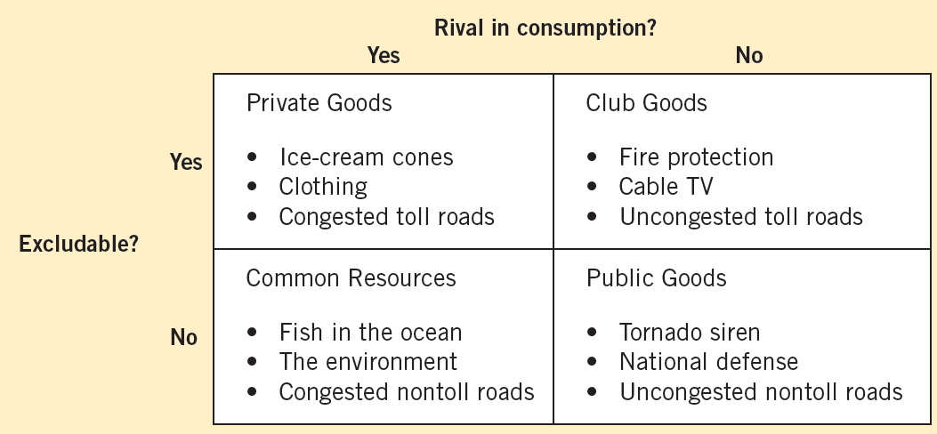
Figure 1
Four Types of Goods
Goods can be grouped into four categories according to two characteristics: (1) A good is excludable if people can be prevented from using it. (2) A good is rival in consumption if one person’s use of the good diminishes other people’s use of it. This diagram gives examples of goods in each category.
© 2015 Cengage Learning. All Rights Reserved. May not be copied, scanned, or duplicated, in whole or in part, except for use as permitted in a license distributed with a certain product or service or otherwise on a password-protected website for classroom use.

Slide 5
The Different Kinds of Goods
Public goods and common resources
  Not excludable
    People cannot be prevented from using them
    Available to everyone free of charge
  No price attached to it
  External effects
    Positive externalities (public goods)
    Negative externalities (common resources)
© 2015 Cengage Learning. All Rights Reserved. May not be copied, scanned, or duplicated, in whole or in part, except for use as permitted in a license distributed with a certain product or service or otherwise on a password-protected website for classroom use.

Slide 6
The Different Kinds of Goods
Public goods and common resources
  Private decisions about consumption and production
    Can lead to an inefficient allocation of resources
  Government intervention
    Can potentially raise economic well-being
© 2015 Cengage Learning. All Rights Reserved. May not be copied, scanned, or duplicated, in whole or in part, except for use as permitted in a license distributed with a certain product or service or otherwise on a password-protected website for classroom use.

Slide 7
Public Goods
Free rider
  Person who receives the benefit of a good but avoids paying for it
The free-rider problem
  Public goods are not excludable
  Prevents the private market from supplying the goods
© 2015 Cengage Learning. All Rights Reserved. May not be copied, scanned, or duplicated, in whole or in part, except for use as permitted in a license distributed with a certain product or service or otherwise on a password-protected website for classroom use.

Slide 8
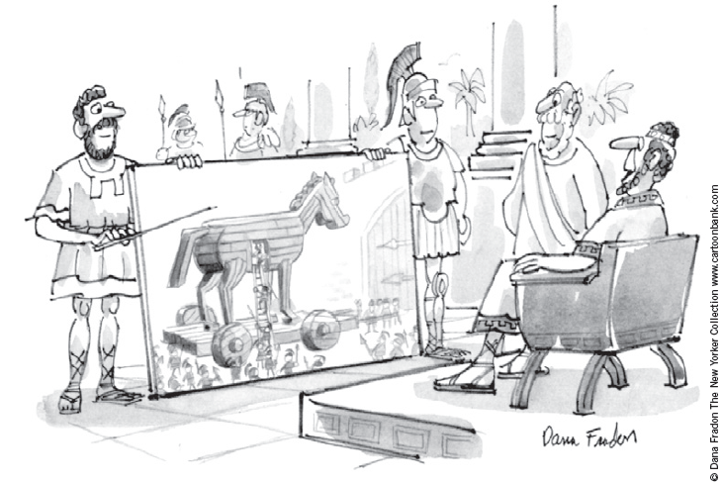
Public Goods
Government can remedy the free-rider problem
  If total benefits of a public good exceeds its costs
  Provide the public good
  Pay for it with tax revenue
  Make everyone better off
“I like the concept if we can do it with no new taxes.”
© 2015 Cengage Learning. All Rights Reserved. May not be copied, scanned, or duplicated, in whole or in part, except for use as permitted in a license distributed with a certain product or service or otherwise on a password-protected website for classroom use.

Slide 9
Public Goods
Some important public goods
  National defense
    Very expensive public good
    $717 billion in 2011
  Basic research
    General knowledge
    Subsidized by government
    The public sector fails to pay for the right amount and the right kinds
© 2015 Cengage Learning. All Rights Reserved. May not be copied, scanned, or duplicated, in whole or in part, except for use as permitted in a license distributed with a certain product or service or otherwise on a password-protected website for classroom use.

Slide 10
Public Goods
Some important public goods
  Antipoverty programs (financed by taxes)
    Welfare system (Temporary Assistance for Needy Families program, TANF)
      Provides a small income for some poor families
    Food stamps (Supplemental Nutrition Assistance Program, SNAP)
      Subsidize the purchase of food for those with low incomes
    Government housing programs
      Make shelter more affordable
© 2015 Cengage Learning. All Rights Reserved. May not be copied, scanned, or duplicated, in whole or in part, except for use as permitted in a license distributed with a certain product or service or otherwise on a password-protected website for classroom use.

Slide 11

Are lighthouses public goods?
Lighthouses
  Mark specific locations so that passing ships can avoid treacherous waters
    Benefit: to the ship captain
      Not excludable, not rival in consumption
    Incentive: free ride without paying
  Most are operated by the government
What kind of good is this?
© 2015 Cengage Learning. All Rights Reserved. May not be copied, scanned, or duplicated, in whole or in part, except for use as permitted in a license distributed with a certain product or service or otherwise on a password-protected website for classroom use.

Slide 12
Are lighthouses public goods?
In some cases
  Lighthouses are closer to private goods
    Coast of England, 19th century
    Lighthouses were privately owned and operated
    The owner of the lighthouse charged the owner of the nearby port
      If the port owned did not pay, lighthouse owner turned the light off
        Ships avoided that port
© 2015 Cengage Learning. All Rights Reserved. May not be copied, scanned, or duplicated, in whole or in part, except for use as permitted in a license distributed with a certain product or service or otherwise on a password-protected website for classroom use.

Slide 13
Are lighthouses public goods?
Decide whether something is a public good
  Determine who the beneficiaries are
  Determine whether the beneficiaries can be excluded from using the good
A free-rider problem
  When the number of beneficiaries is large
  Exclusion of any one of them is impossible
© 2015 Cengage Learning. All Rights Reserved. May not be copied, scanned, or duplicated, in whole or in part, except for use as permitted in a license distributed with a certain product or service or otherwise on a password-protected website for classroom use.

Slide 14
Public Goods
The difficult job of cost–benefit analysis
  Government
    Decide what public goods to provide
    In what quantities
  Cost–benefit analysis
    Compare the costs and benefits to society of providing a public good
    Doesn’t have any price signals to observe
    Government findings
      Rough approximations at best
© 2015 Cengage Learning. All Rights Reserved. May not be copied, scanned, or duplicated, in whole or in part, except for use as permitted in a license distributed with a certain product or service or otherwise on a password-protected website for classroom use.

Slide 15
How much is a life worth?
Cost: $10,000 for a new traffic light
Benefit: increased safety
  Risk of a fatal traffic accident
    Drops from 1.6% to 1.1 %
Obstacle
  Measure costs and benefits in the same units
Put a dollar value on a human life?
  Priceless = infinite dollar value
© 2015 Cengage Learning. All Rights Reserved. May not be copied, scanned, or duplicated, in whole or in part, except for use as permitted in a license distributed with a certain product or service or otherwise on a password-protected website for classroom use.

Slide 16
How much is a life worth?
Implicit dollar value of a human life
  Courts: award damages in wrongful-death suits
    Total amount of money a person would have earned if he or she had lived
    Ignores other opportunity costs of losing one’s life
  Risks that people are voluntarily willing to take and how much they must be paid for taking them
    Value of human life = $10 million
© 2015 Cengage Learning. All Rights Reserved. May not be copied, scanned, or duplicated, in whole or in part, except for use as permitted in a license distributed with a certain product or service or otherwise on a password-protected website for classroom use.

Slide 17
How much is a life worth?
Cost-benefit analysis
  Traffic light
    Reduces risk of fatality by 0.5 percentage points
  Expected benefit = 0.005 × $10 million = $50,000
  Cost ($10,000) < Benefit ($50,000)
  Approve the traffic light
© 2015 Cengage Learning. All Rights Reserved. May not be copied, scanned, or duplicated, in whole or in part, except for use as permitted in a license distributed with a certain product or service or otherwise on a password-protected website for classroom use.

Slide 18
Common Resources
Common resources
  Not excludable
  Rival in consumption
The tragedy of the commons
  Parable that shows why common resources are used more than desirable
    From society’s standpoint
  Social and private incentives differ
  Arises because of a negative externality
© 2015 Cengage Learning. All Rights Reserved. May not be copied, scanned, or duplicated, in whole or in part, except for use as permitted in a license distributed with a certain product or service or otherwise on a password-protected website for classroom use.

Slide 19
Common Resources
The tragedy of the commons
  Negative externality
    One person uses a common resource
      Diminishes other people’s enjoyment of it
    Common resources tend to be used excessively
  Government can solve the problem
    Regulation or taxes to reduce consumption of the common resource
    Turn the common resource into a private good
© 2015 Cengage Learning. All Rights Reserved. May not be copied, scanned, or duplicated, in whole or in part, except for use as permitted in a license distributed with a certain product or service or otherwise on a password-protected website for classroom use.

Slide 20
Common Resources
Some important common resources
  Clean air and water
    Negative externality: pollution
    Regulations or corrective taxes
  Congested roads
    Negative externality: congestion
    Corrective tax: charge drivers a tool
    Tax on gasoline
© 2015 Cengage Learning. All Rights Reserved. May not be copied, scanned, or duplicated, in whole or in part, except for use as permitted in a license distributed with a certain product or service or otherwise on a password-protected website for classroom use.

Slide 21
Common Resources
Some important common resources
  Fish, whales, and other wildlife
    Oceans are the least regulated common resource
      Needs international cooperation
      Difficult to enforce an agreement
    Fishing and hunting licenses
    Limits on fishing and hunting seasons
    Limits on size of fish
    Limits on quantity of animals killed
© 2015 Cengage Learning. All Rights Reserved. May not be copied, scanned, or duplicated, in whole or in part, except for use as permitted in a license distributed with a certain product or service or otherwise on a password-protected website for classroom use.

Slide 22
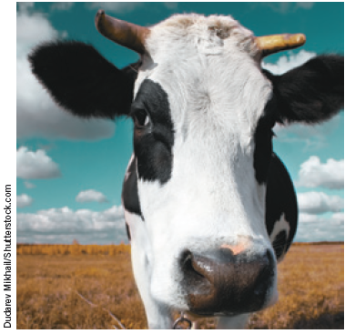
Why the cow is not extinct
Animals with commercial value that are threatened with extinction
  Buffalo
    North America
    Hunting in 19th century
  Elephants
    African countries
    Hunting today
‘Will the market protect me?’
© 2015 Cengage Learning. All Rights Reserved. May not be copied, scanned, or duplicated, in whole or in part, except for use as permitted in a license distributed with a certain product or service or otherwise on a password-protected website for classroom use.

Slide 23
Why the cow is not extinct
The cow
  Commercial value
  Species continues to thrive
Cows are a private good
  Ranches are privately owned
  Rancher - great effort to maintain the cattle population on his ranch
    Reaps the benefit
© 2015 Cengage Learning. All Rights Reserved. May not be copied, scanned, or duplicated, in whole or in part, except for use as permitted in a license distributed with a certain product or service or otherwise on a password-protected website for classroom use.

Slide 24
Why the cow is not extinct
Elephant - common resource
  Poachers are numerous
    Strong incentive to kill elephants
Government of Kenya, Tanzania, and Uganda
  Illegal to kill elephants and sell ivory
  Hard to enforce laws
  Decreasing population of elephants
© 2015 Cengage Learning. All Rights Reserved. May not be copied, scanned, or duplicated, in whole or in part, except for use as permitted in a license distributed with a certain product or service or otherwise on a password-protected website for classroom use.

Slide 25
Why the cow is not extinct
Government of Botswana, Malawi, Namibia, and Zimbabwe
  Made elephants a private good
  People can kill elephants on their own property
  Landowners have an incentive to preserve the species
  Elephant populations have started to rise
© 2015 Cengage Learning. All Rights Reserved. May not be copied, scanned, or duplicated, in whole or in part, except for use as permitted in a license distributed with a certain product or service or otherwise on a password-protected website for classroom use.

Slide 26
Importance of Property Rights
Market fails to allocate resources efficiently
  Because property rights are not well established
  Some item of value does not have an owner with the legal authority to control it
© 2015 Cengage Learning. All Rights Reserved. May not be copied, scanned, or duplicated, in whole or in part, except for use as permitted in a license distributed with a certain product or service or otherwise on a password-protected website for classroom use.

Slide 27
Importance of Property Rights
The government can potentially solve the problem
  Help define property rights and thereby unleash market forces
  Regulate private behavior
  Use tax revenue to supply a good that the market fails to supply
© 2015 Cengage Learning. All Rights Reserved. May not be copied, scanned, or duplicated, in whole or in part, except for use as permitted in a license distributed with a certain product or service or otherwise on a password-protected website for classroom use.

